Slide 1
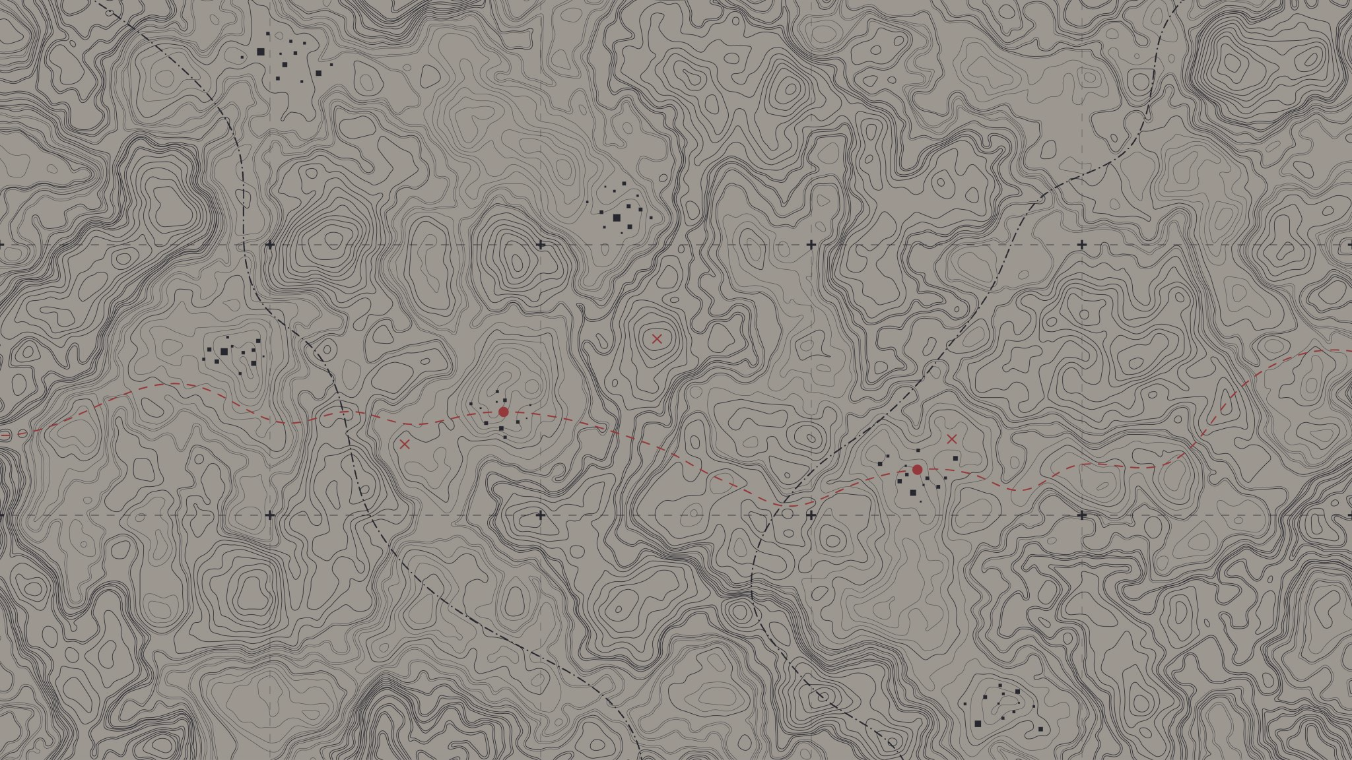
Building a map of machine learning
Dr Stuart Burrell
Senior Research Engineer at Featurespace

Slide 2
Building a map of machine learning artificial intelligence
Dr Stuart Burrell
Senior Research Engineer at Featurespace

Slide 3
Goal of this talk
To learn how machine learning relates to your knowledge of other tools, and how you might apply it to your problems

Slide 4
Plan
Introduce machine learning
Designing machine learning experiments and architectures
Investigate some real-world applications of machine learning

Slide 5
Plan
Introduce machine learning
Designing machine learning experiments and architectures
Investigate some real-world applications of machine learning

Slide 6
What is machine learning?
Machine learning is a set of tools to solve a wide-variety of predictive problems
These problems can be categorized into:
Supervised learning
Unsupervised learning
Reinforcement learning

Slide 7
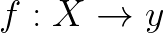

Supervised learning
Data
Labels
Classification: “Cat” or “Dog” Regression: 10.5kg, 12kg

Slide 8

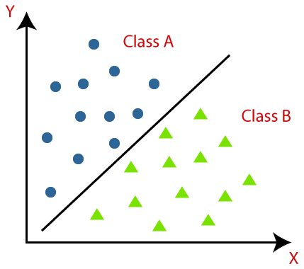
Supervised learning

Slide 9

Unsupervised learning

Slide 10
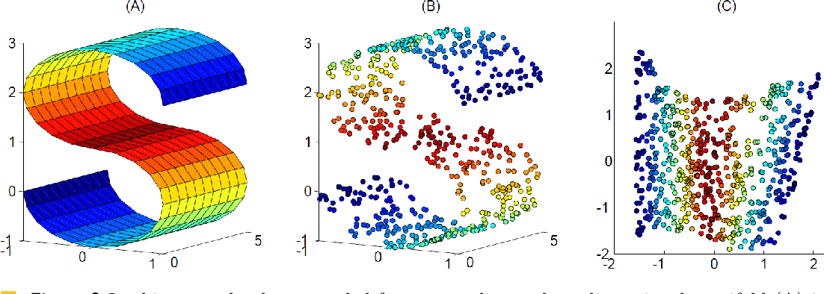
Unsupervised learning

Slide 11

Reinforcement learning

Slide 12
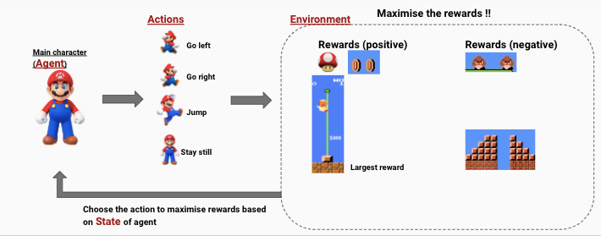
Reinforcement learning

Slide 13
To recap
Supervised learning: approximates a function mapping data to labels
Unsupervised learning: detects structure like clusters, associations or lower dimensional representations
Reinforcement learning – approximates a function showing how to act in given an environment to maximize reward

Slide 14
Where does statistics fit into all of this?

Slide 15
Inference and prediction
“Inference creates a mathematical model of the data-generation process to formalize understanding or test a hypothesis" (Bzdok et al. 2018).
“Prediction aims at forecasting unobserved outcomes or future behavior” (Bzdok et al. 2018).
Bzdok, D., Altman, N. & Krzywinski, M. Statistics versus machine learning. Nat Methods 15, 233–234 (2018).

Slide 16
“Statistics draws population inferences from a sample, and machine learning finds generalizable predictive patterns.” Bzdok, D., Altman, N. & Krzywinski, M. Statistics versus machine learning. Nat Methods 15, 233–234 (2018).

Slide 17
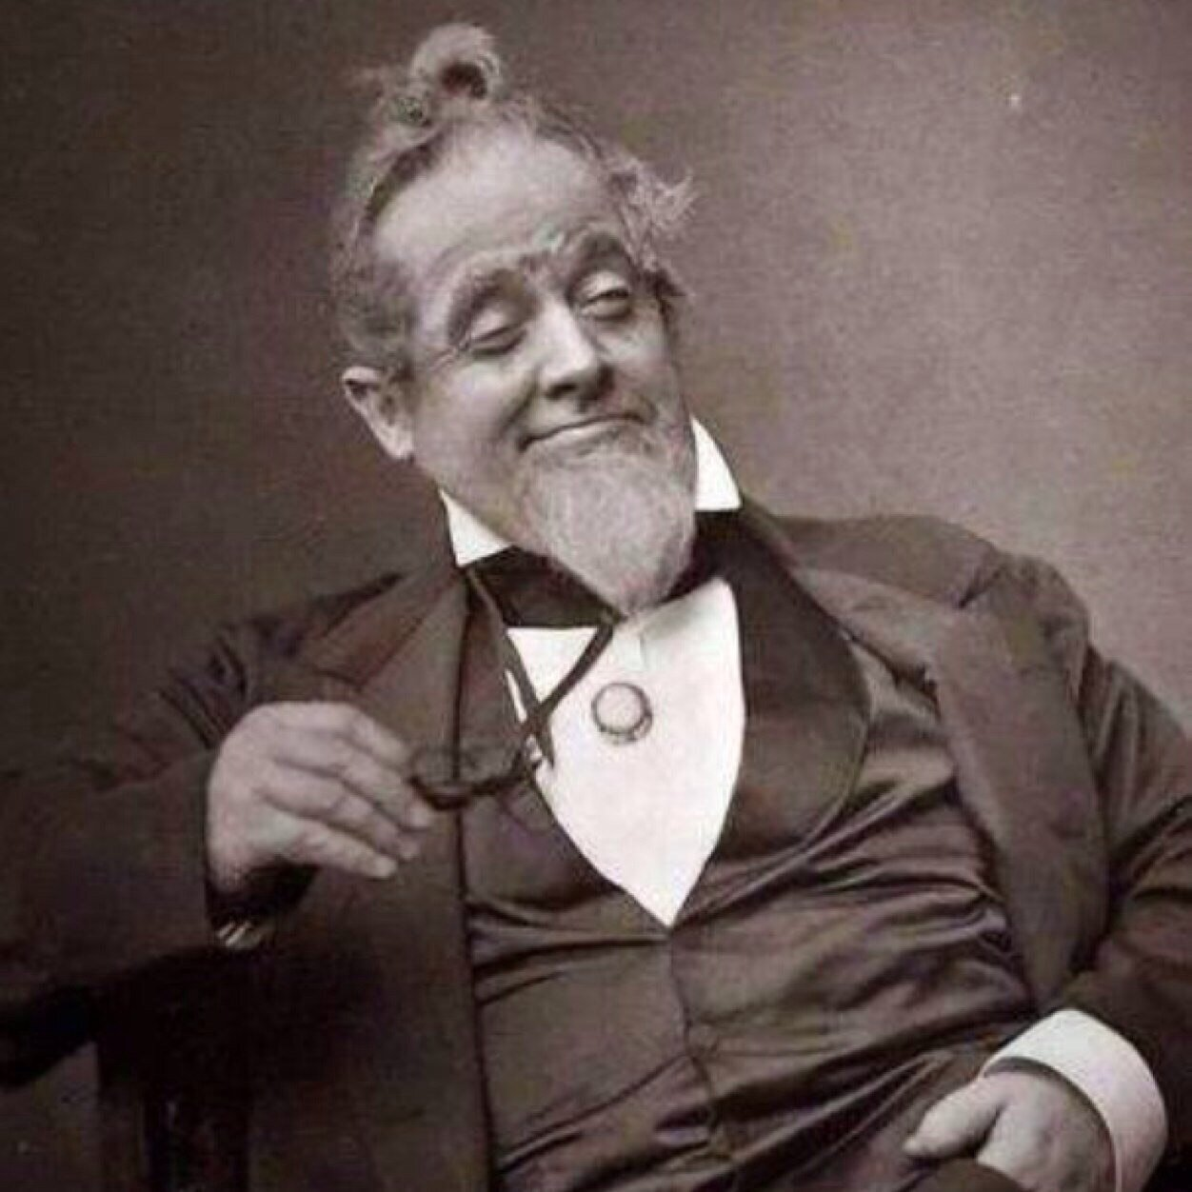
So, is statistics the proper way of doing things?

Slide 18





Slide 19
“All models are wrong, but some are useful.” George E. P. Box

Slide 20
Some middle-ground
Probabilistic machine learning approaches like Bayesian neural networks offer approximate estimates of uncertainty for weights and predictions.
Explainable AI aims to develop techniques for interpreting black-box models, usually through feature importance or example importance.
Mechanistic interpretability attempts to uncover conceptual understanding of individual weights even in ~billion weight scale parameter models.

Slide 21
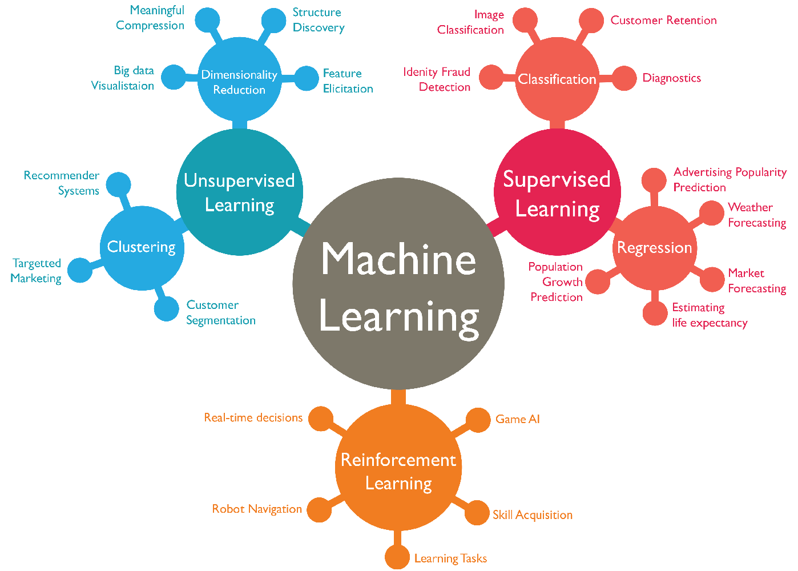

Slide 22

Question time

Slide 23
Plan
Introduce machine learning
Designing machine learning experiments and architectures
Investigate some real-world applications of machine learning

Slide 24
The machine learning process
Define the problem
Acquire the data
Design the evaluation
Build a model
Iterate on the model
A lot of people start here!

Slide 25
Define the problem
What is the function you are trying to learn?
What are the inputs and outputs of this function?
Is this a prediction problem or an inference problem?

Slide 26
Acquire the data
Split the data into training, validation and testing partitions
Does the data have signal for the problem you’re trying to solve?
How much data and/or labels do you have?
What simple statistics can you compute about the data? (EDA)
Can the data be reduced, filtered, or simplified in any way?

Slide 27
Design the evaluation
How will you know if you’ve solved the problem?
Is there a quantitative measure of this, for example, prediction accuracy?
May be nuanced – are there multiple measures of quality?

Slide 28
Example: how to evaluate a probabilistic forecasting model?

Slide 29
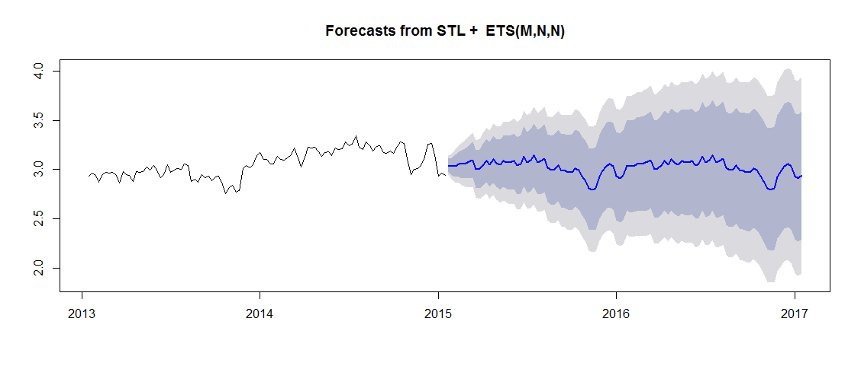
Evaluating forecasts: mean and variance?

Slide 30
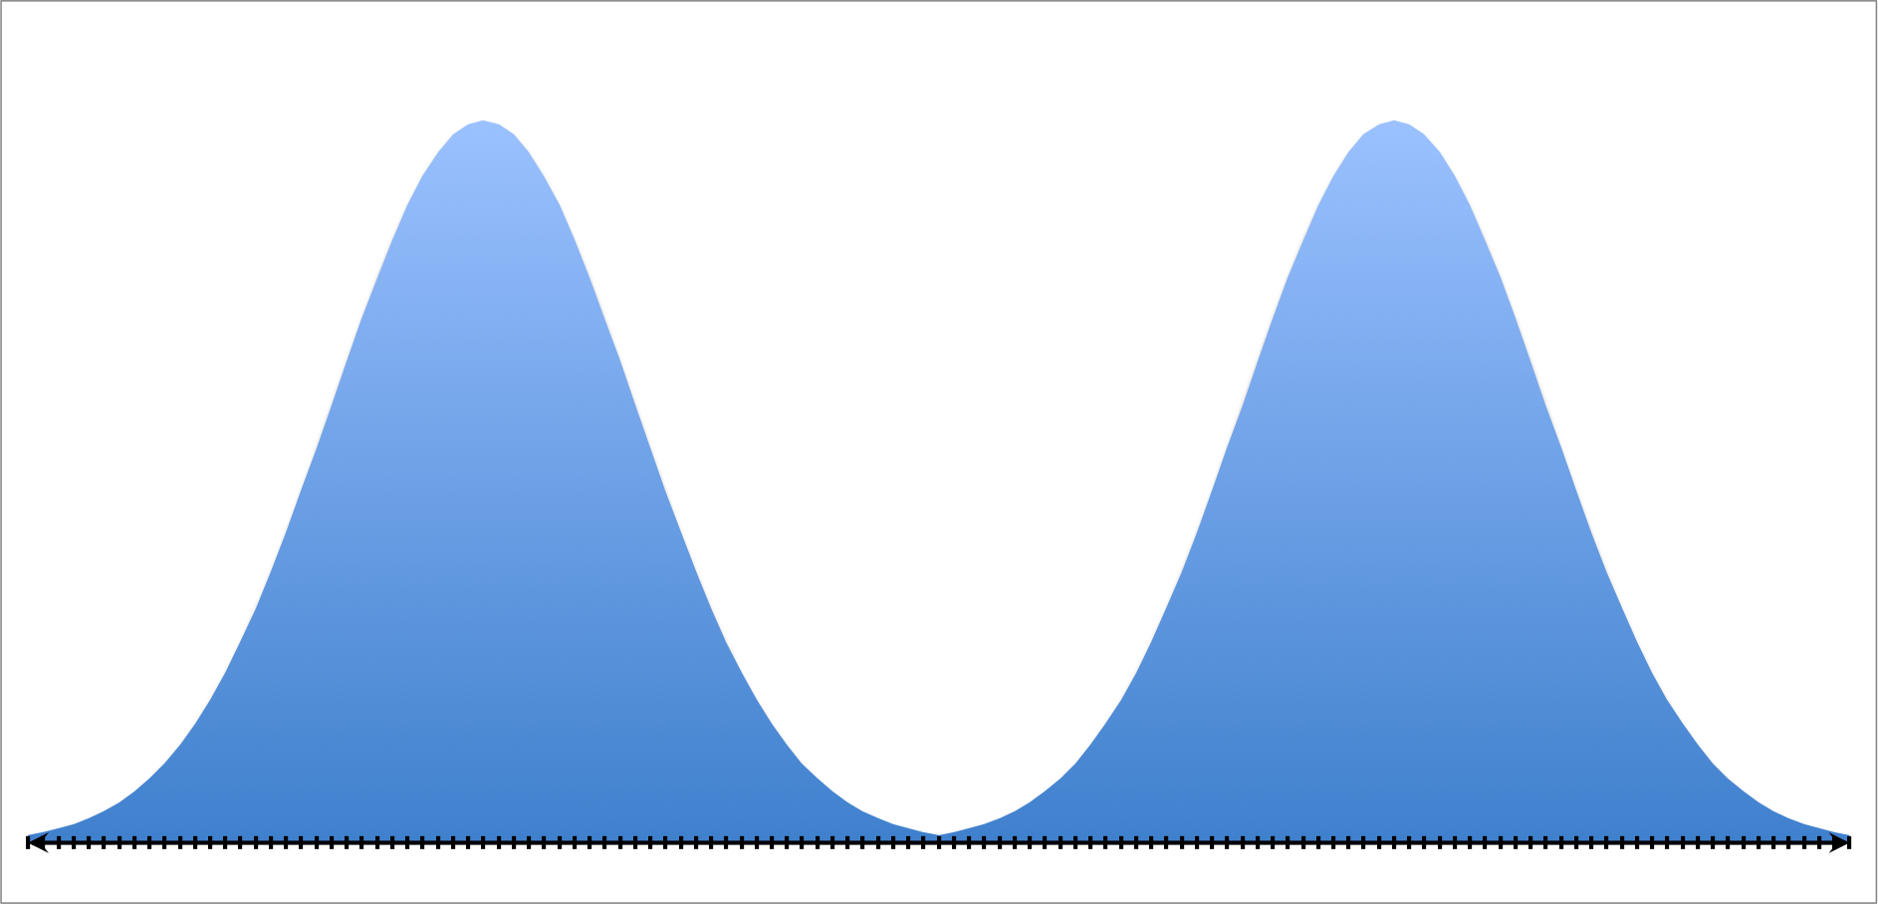
Evaluating forecasts: multimodality?
Ground truth may represent one of several plausible options, so we
could end up optimizing to an unfortunate middle-ground!

Slide 31
Evaluation can be hard. Get it wrong and everything else can be futile!

Slide 32
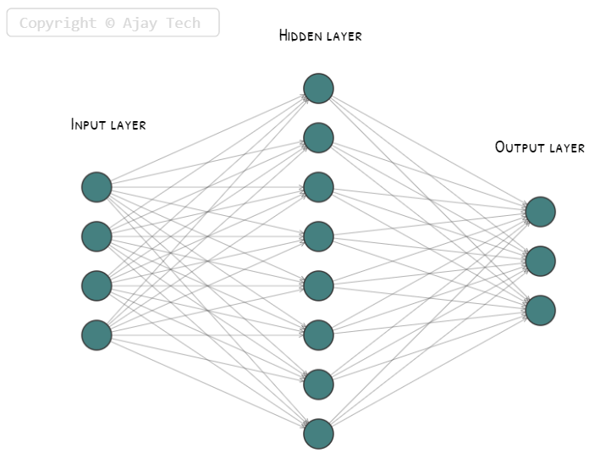
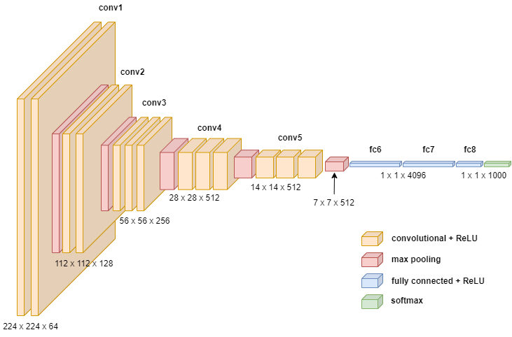
Build a model

Slide 33
Pause! How far did we get before discussing architectures and models?

Slide 34
Key models
Rules based systems
Decision trees and gradient boosting
Neural networks (MLPs, RNNs, CNNs, Transformers, GNNs, …)

Slide 35
Rules based systems
If AMOUNT > $10000 then predict FRAUD else predict GENUINE

Slide 36
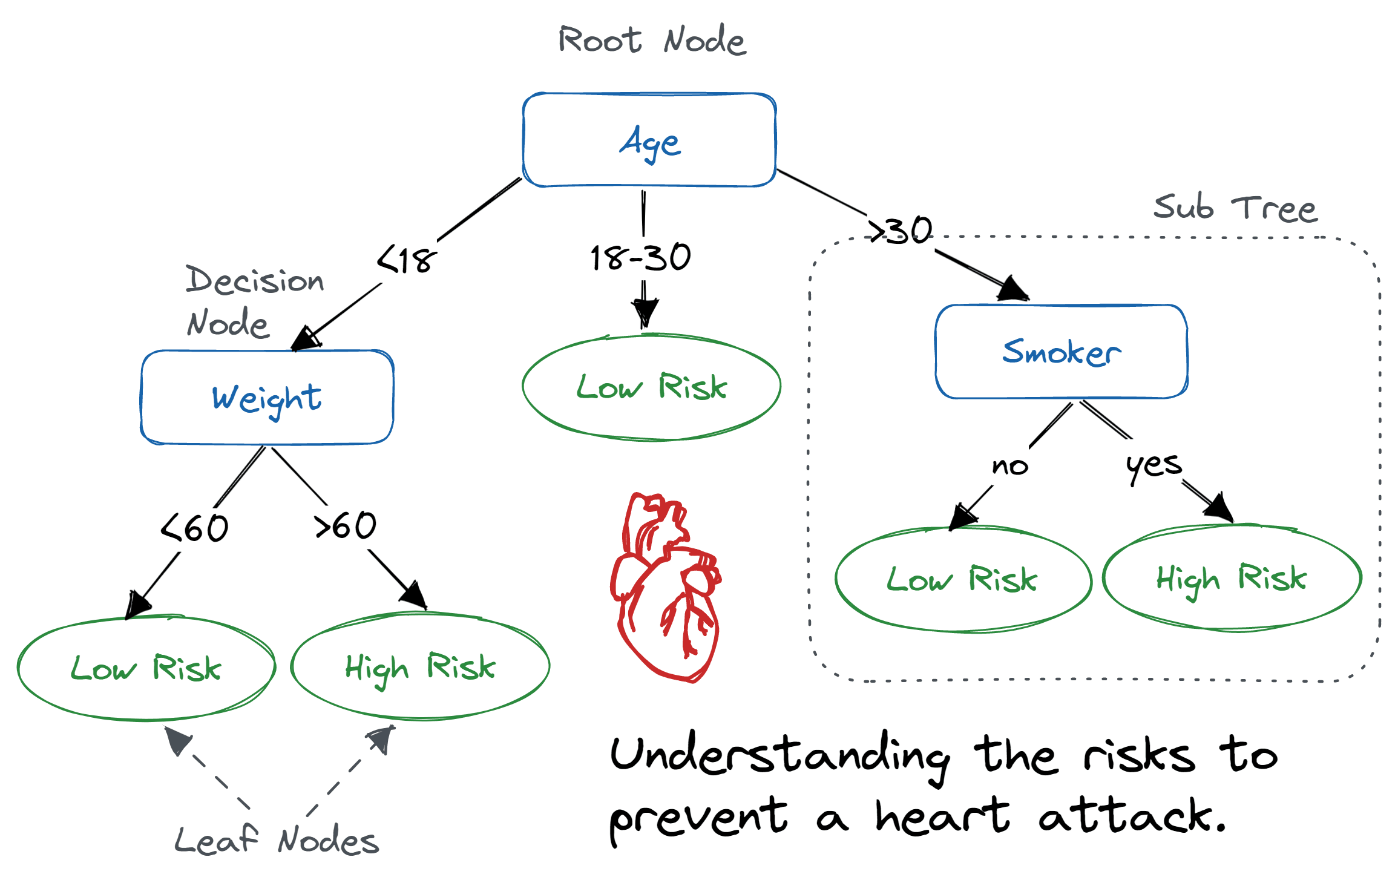
Decision trees

Slide 37
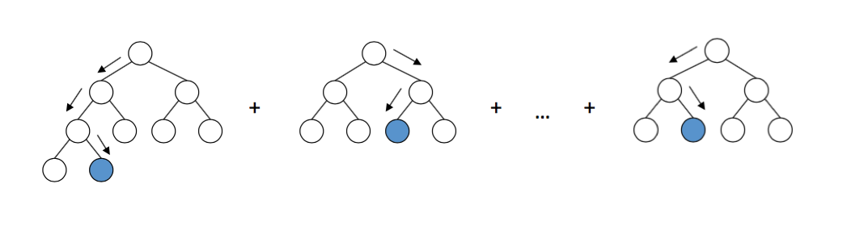
Gradient boosted trees

Slide 38

Neural networks

Slide 39
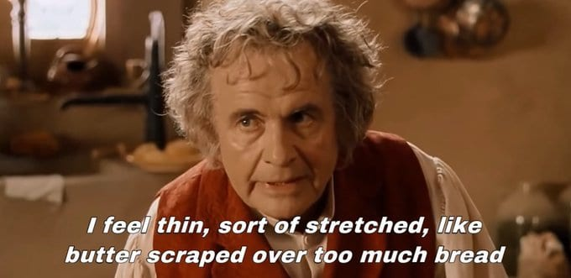
Neural networks

Slide 40
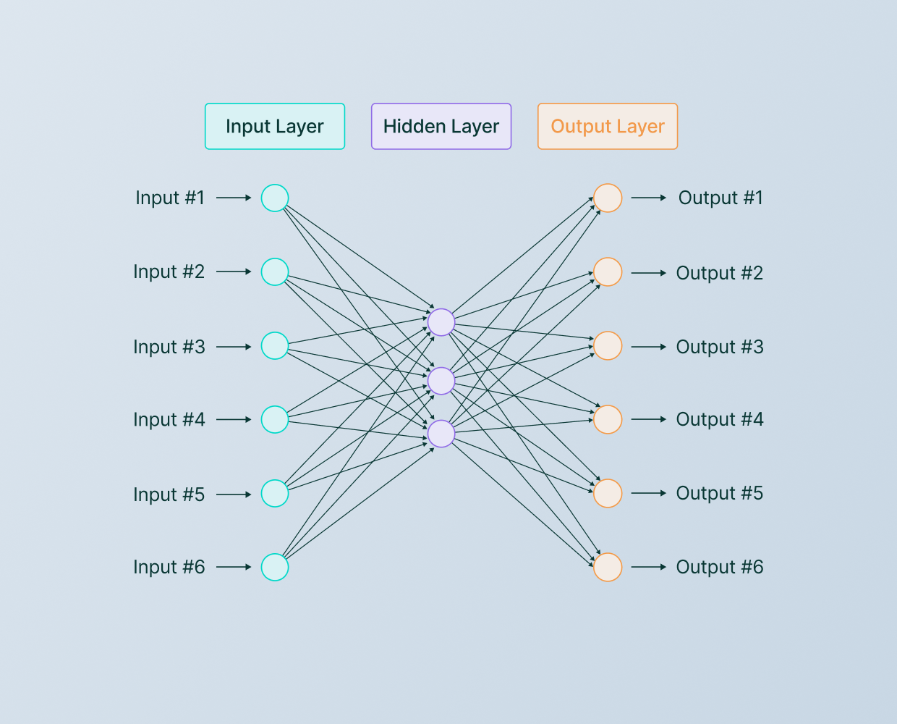
Neural networks

Slide 41

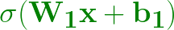
Neural network (Multi-layer perceptron)
1-layer MLP
2-layer MLP
And so on…

Slide 42
Training neural networks: back-propagation
The model is just a function that produces outputs and ML is function approximation
Decide on a loss function that measures how good the output is compared to a given target (training example).
Compute the gradient of the loss with respect to each weight and take a small step in the opposite direction.

Slide 43

Training neural networks: visualized
Loss

Slide 44
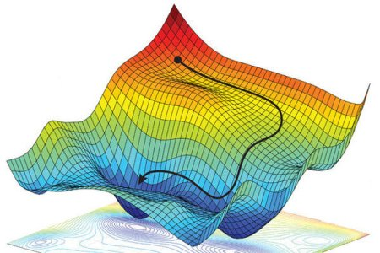
Not so fast…

Slide 45
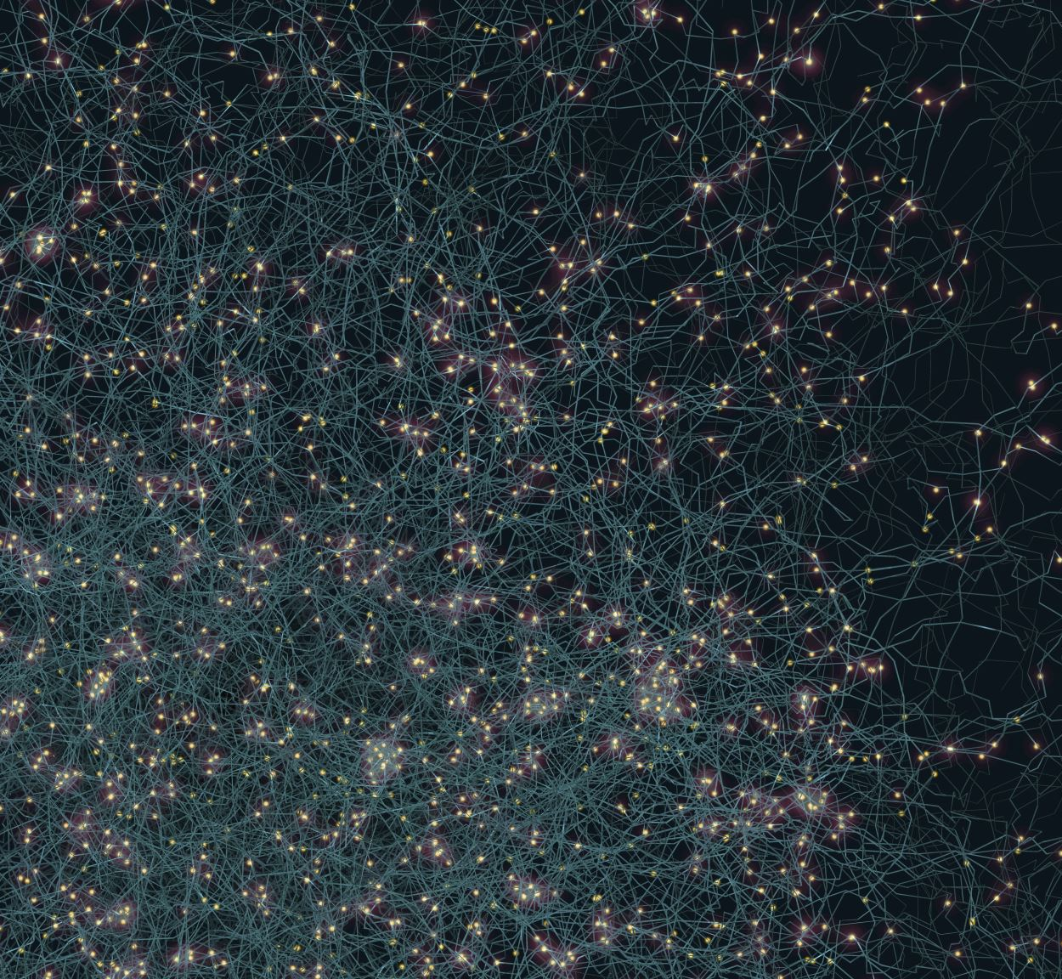
Iterate on the model
Type of model (neural network, decision trees, …)
Vast array of design choices:
Depth of the network
Width of the network
Choice of activations
And many more!

Slide 46
Architectures – general principles
Golden rule: start simple and work your way up
Understanding how a simple model fails is key to designing the right complex model
The assumptions of the model should reflect the structure of the data

Slide 47
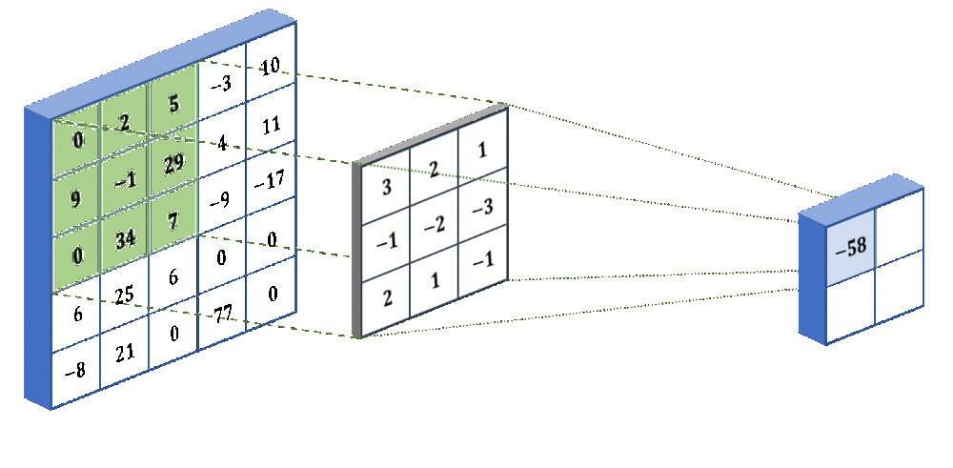
Example – convolutional neural networks

Slide 48
Question time

Slide 49
Plan
Introduce machine learning
Designing machine learning experiments and architectures
Investigate some real-world applications of machine learning

Slide 50
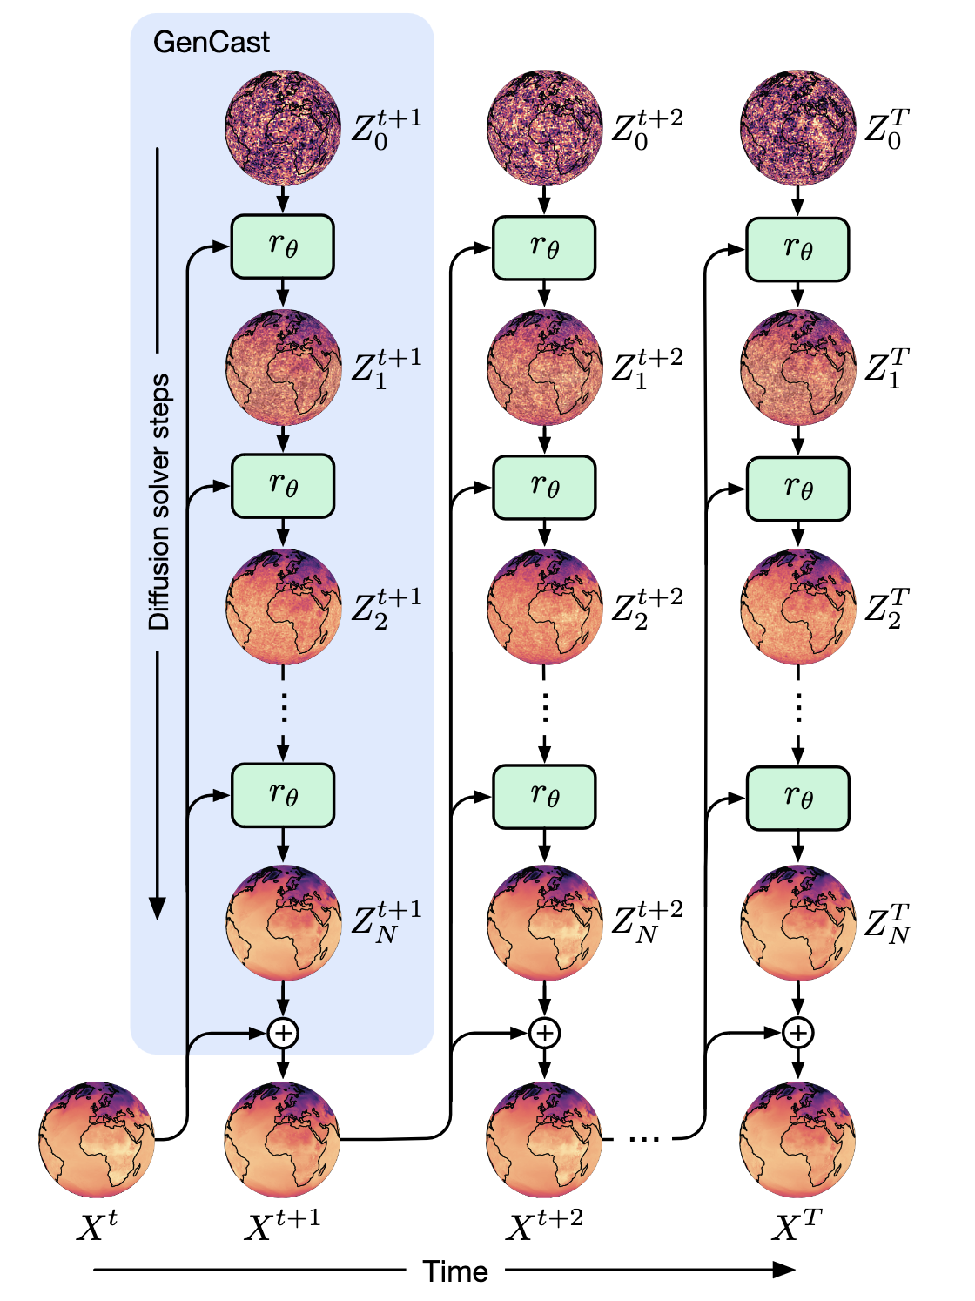
Example 1: GenCast forecasting

Slide 51
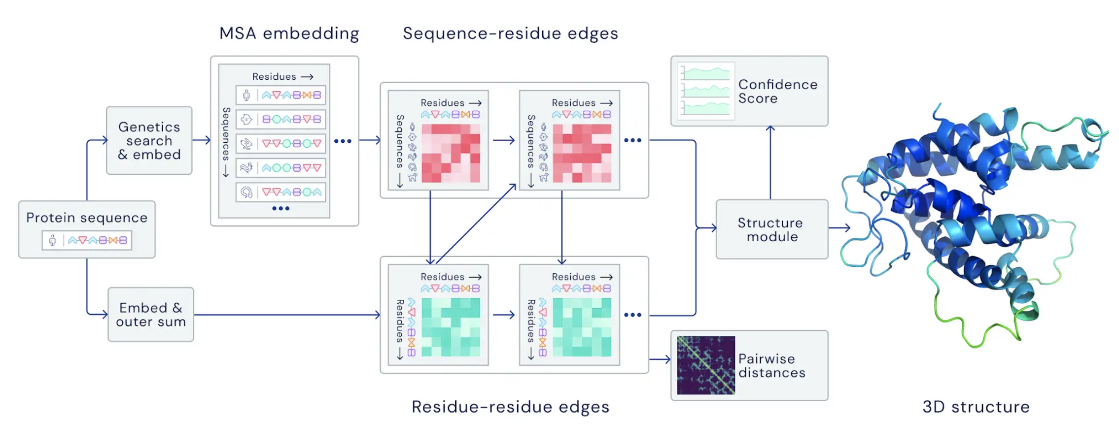
Example 2: AlphaFold

Slide 52
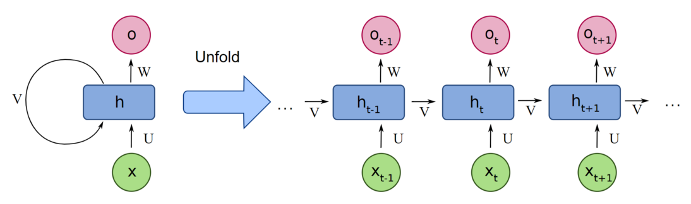
Example 3: language generation
Recurrent architectures – traditional sequence models

Slide 53
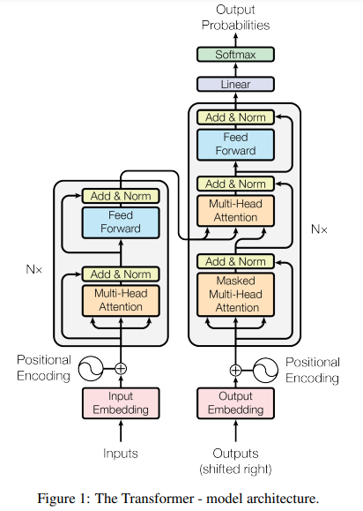
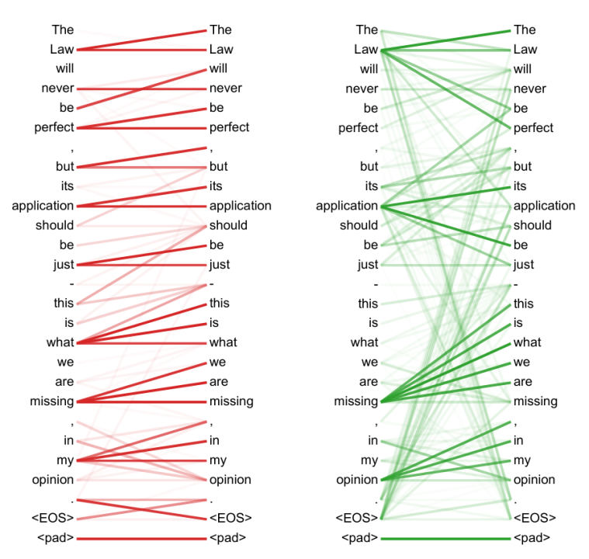
Example 3: language generation
Attention mechanisms

Slide 54
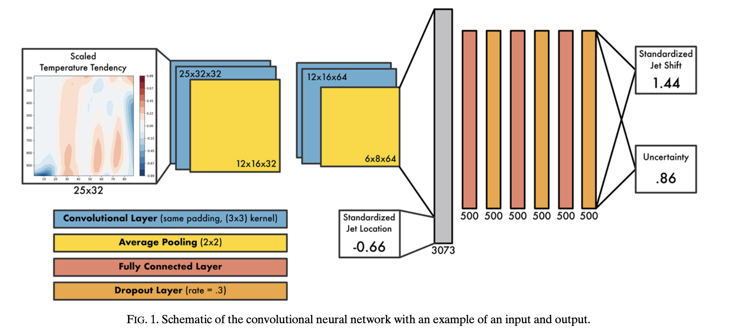
Example 4: jet stream analysis
Connolly, Charlotte et al.. 2023. “Using Neural Networks to Learn the Jet Stream Forced Response from Natural Variability.”
Artificial Intelligence for the Earth Systems 2 (2). https://doi.org/10.1175/AIES-D-22-0094.1

Slide 55
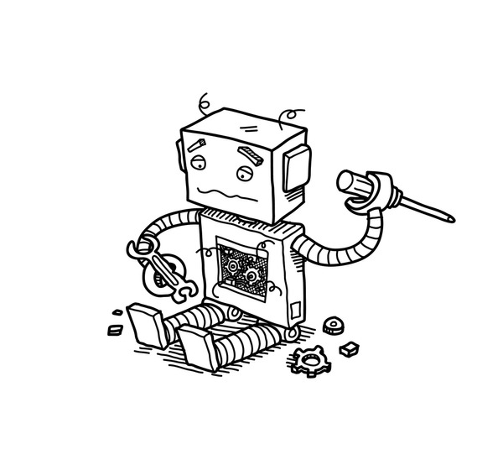
Machine learning gone wrong!
Adversarial attacks
Specification gaming
Goal misgeneralisation

Slide 56
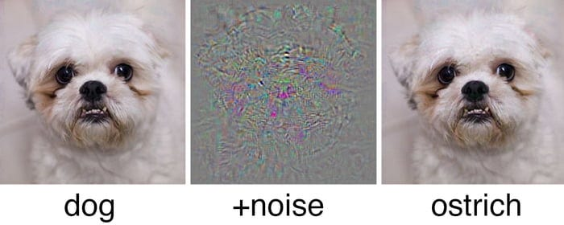
Adversarial attacks

Slide 57
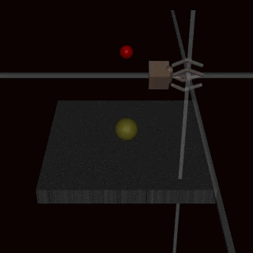
Specification gaming

Slide 58
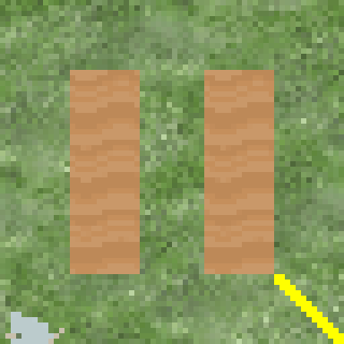
Goal misgeneralisation

Slide 59
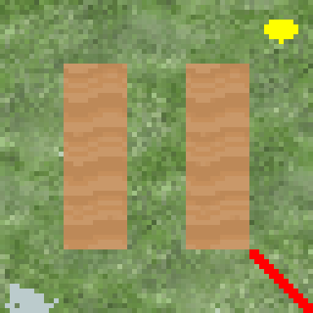
Goal misgeneralisation

Slide 60
Key take-aways
Treat machine learning as a craft
Start with the problem, the data, and the evaluation
Data geometry should reflect model assumptions

Slide 61
Discussion and questions!
About anything in the talk so far
How ML might be applied to your problems
Careers advice in ML

